Slide 1
Enhancing Quality Through Communication
A Rural Perspective on How Feedback Enhances Care
Jodi Peppers RN BSN CEN
PI Nurse
Julie Andersen RN BSN
Trauma Program Manger
Notes:
I was able to attend 2024 TQIP with my team and our TPM had the honor of presenting so this presentation is done in collaboration with her.

Slide 2
Disclosure
Universally Edit the Footer
(This should be one of the first things you do before you start building out your presentation deck)
At the top menu of the window > Insert.
Within the Text category > Header & Footer
In the first tab of the pop-up, in the footer section, it should read “[Presentation title - Please see slide 2 for directions]”
Clear that text field and replace it with a new title.
> Apply to All
You should notice the footer has changed below. Just to be sure, navigate to other slides containing a footer to see if those had changed as well.
*Note* - The purpose of a footer is not only to keep your work organized, but also to identify individual slides should they ever get printed and become lost and/or orphaned. When giving your presentation a new footer, which should be the reiteration of your cover title, it should be specific enough to be identifiable and will not be confused with another presentation or event.
No Conflict of Interest

Slide 3
Objectives
Describe a rural perspective-receiving transfer follow up, feedback, and opportunities for improvement.
Demonstrate the benefits of a collaborative relationship.
Case Review of performance improvement from transfer center feedback

Slide 4
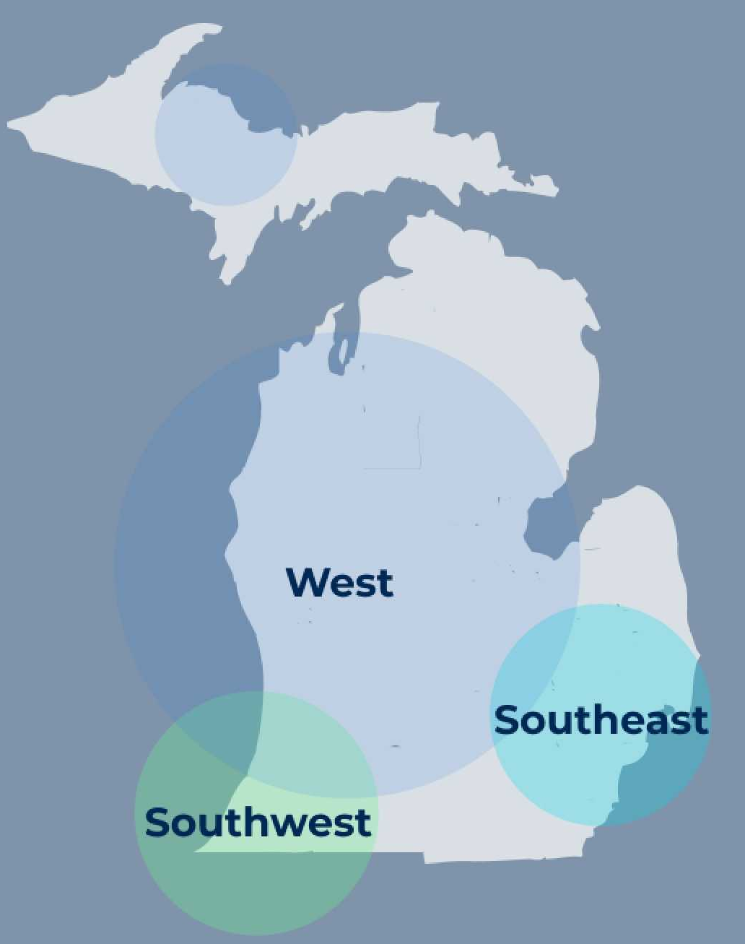
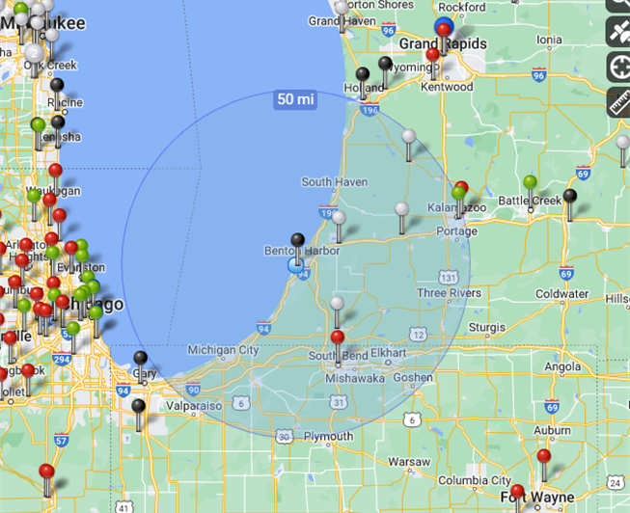
Who We Are: Corewell Health
Corewell Health South
ACS Verified Level III Center
High functioning:
Neurosurgery/IR/OR/whole blood
2 State Designated Level IV Centers
Watervliet: No Surgeon or admissions
Niles: Limited resources/OR
50-mile radius
1 Level one center
2 Level two centers
2 Level four centers
Additional Referral Centers
Level I adult center
Level I pediatric center (74 miles)
Notes:
I think it’s important to explain our system, location, and how we function. Because while we all follow the same standards whether ACS or State we may have different resourses and demographics.
Corewell health is the largest healthcare system in the SOM, with 21 facilities (2022)
It's broken down into three regions South, West, and East
Here is a map that shows the trauma centers within our area.
our Level IV centers look very different,
Watervliet Hospital has no general surgeons and transfers all trauma patients. Their job is to stabilize and transfer.
Niles has general surgeons and the ability to admit stable trauma patients but with limited resources.
Our level IV centers also transfer about 50% of their patients to our level III center, which is a robust trauma program that allows us to keep a large portion of our trauma patients wintin their community.
All three of our centers do receive critical trauma patients, often they are the closest facility and provide the initial care.
Two of our centers are located right off of the busy I-94 interstate.
Our top three MOI
GLF ( geriatric population)
MVCs
and penetrating trauma r/t gun violence.
Whole blood

Slide 5
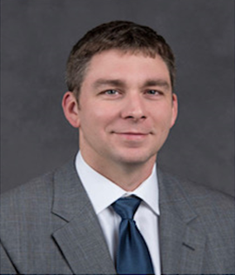
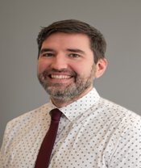
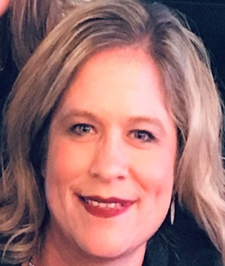
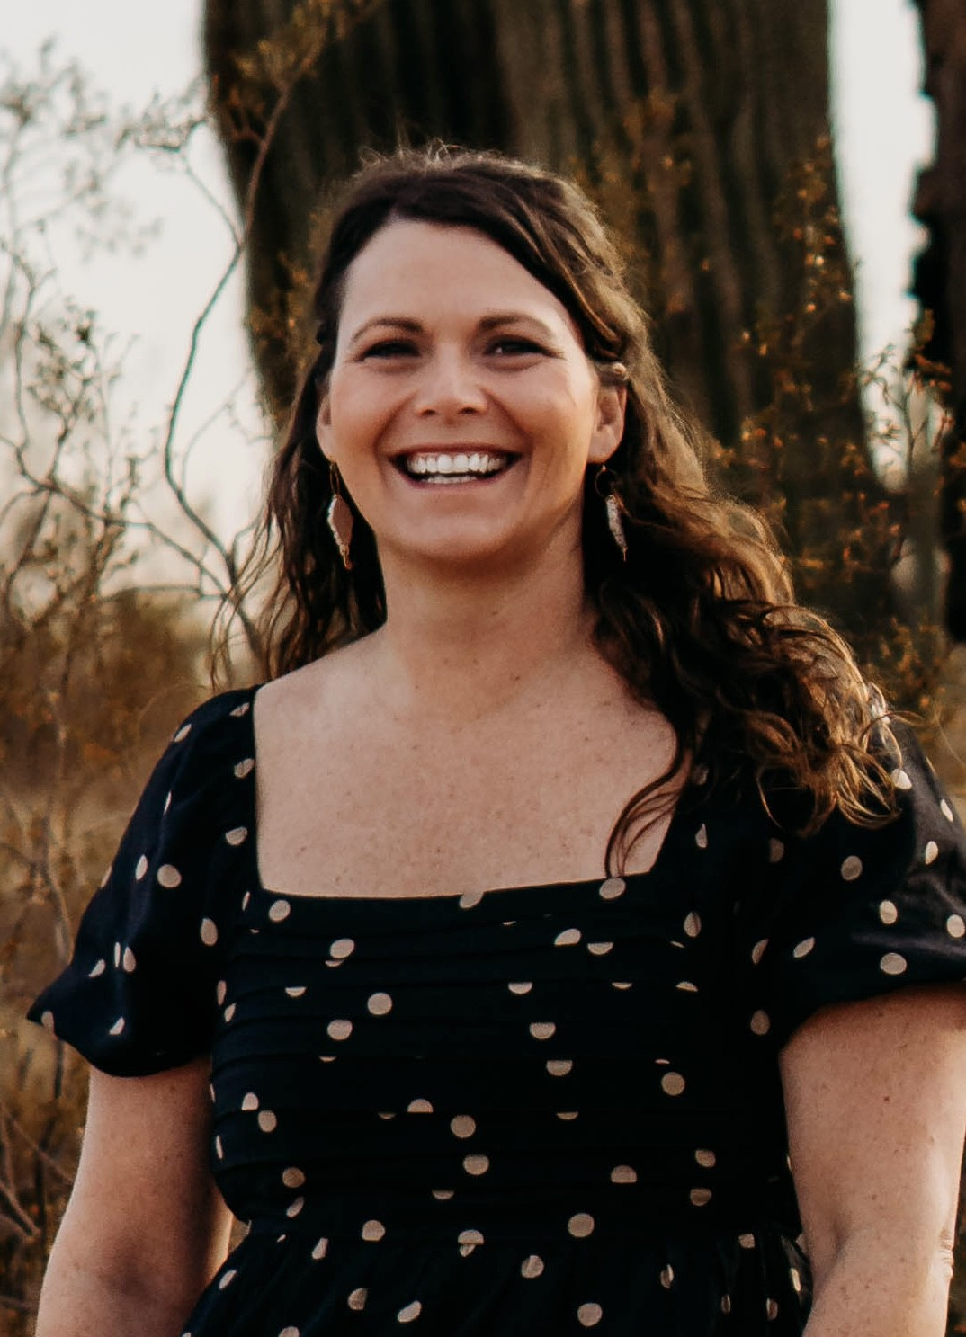
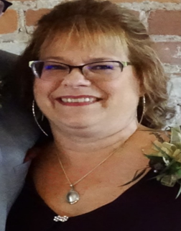
Corewell Health South Trauma Program Team
Craig Kline MD FACS
TMD
Level III
Joe McCarthy
MD BCEM
TMD
Level IV
Jodi Peppers
RN-BSN, CEN
Performance Improvement Nurse
Julie Andersen
RN-BSN
Trauma Program Manager
Rhonda Harlow RN-BSN
Registrar
Notes:
We have a great team. But its important to note that this team oversees our three trauma programs and we do wear multiple hats….IE no dedicated IP roll so we all work together in our community IP efforts and rely on our community partners as well.

Slide 6
Challenges Rural Centers Face
Trauma patient transfers
Specialty physician coverage
Staffing challenges
Maintaining an effective performance improvement program
Notes:
The challenges that rural centers face are the things we like our transfer centers to understand.
It can help when receiving the trauma patient to potentially understand why we may or may not have done something and that our resourses look much different than that of a level 1 or 2 center
Transferring a patient to a higher level of care may be difficult.
Find transportation can be difficult due to availability of our EMS crews or the weather.
This can lead to prolonged ED stays for trauma patients at a facility where they really need to get to a higher level of care.
Specialty physician coverage may not be available at our trauma centers or may not be 24/7.
Or we may not have clinical support for the provider. For example, the surgeon can perform the procedure, but there isn’t clinical or equipment support for the surgeon.
Having staff who have trauma experience and keeping those staff at a rural facility can be a challenge for smaller programs as well.
Loop closure can be difficult, especially with facilities we do not transfer too often because those established relationships aren’t developed).
In rural facilities your trauma program staff wear several hats to include a lot of job duties that could lead to a delay in loop closure.

Slide 7
2022 Standard
CD 7.10 (Type II)
All trauma centers must have a process for reviewing and providing feedback to referring providers, related to the care and outcomes of their patients and any potential opportunities for improvement of initial care.
Notes:
Here is what the 2022 ACS Standard states for feedback
While there is an expectation that referral centers receive feedback, There may be gaps in how that feedback is received. So we’ll talk about our experience for transfer feedback and how we apply it.

Slide 8
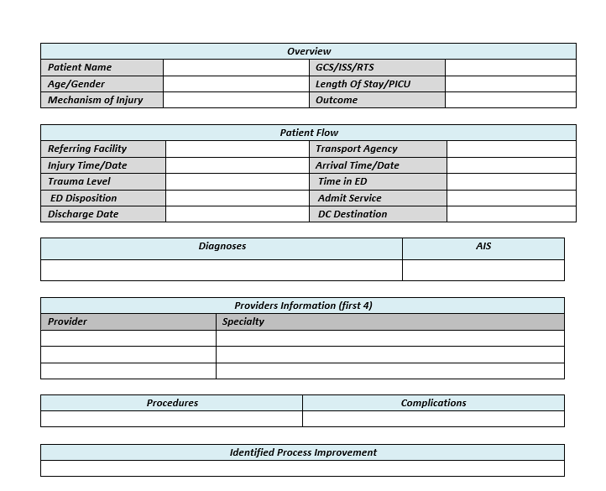
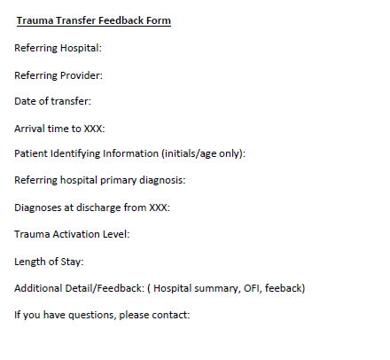
Methods of Receiving Feedback
Templated transfer follow-up
Vary by center, received after abstraction
Notes:
For our centers about 75% of transfer follow up is received this way.
Templated- some information maybe generated from the trauma registry
Not all transfer follow up summaries are the same format, as you can see two different variations her
The contents and layout varies by facility.
Transfer f/u’s is usually received after the patient’s chart has been abstracted so it could be 60 days or more after the patient has been discharged.
Transfer summaries are sent through a Secure platform- whether that is a secure email delivery or a platform where the we log into the receiving facilities platform to review the transfer summary.
We do find that this templated format is often used for transfers with out high indication for OFI.

Slide 9
Methods of Receiving Feedback
Direct communication
Email, Phone call, Face to face
Notes:
Direct communication accounts for the other 25% of transfer follow up communication.
1. It can occur at any aspect of the patients care and from different members on the trauma team. This could be the TMD, TPM, or PI nurse.
2. Usually occurs close to transfer date and the patient can still be admitted at the accepting facility
3. helps with clarification of treatment from between trauma centers
4. Supports providing real time feedback
5. It helps gather the entire picture
6. Allowing back and forth dialog
Conversation log
Is part of your PI process and documents the conversation and helps close the loop on communication.

Slide 10
How do we use feedback summary?
Review Details
Length of Stay
Consults
Injuries
Complications
Summary of visit
Identified opportunities for improvement
Notes:
When we receive feedback there is key information that we look for.
It’s a tool for our program
1. Did we follow ATLS guidelines
2. Did we perform the interventions needed prior to transfer without delaying transfer
3. Did we identify the same injuries that were identified at the accepting facility, or do we need to investigate if it was a missed injury
4. Did the patient meet transfer criteria
5. Did the patient develop any complications and if so, was there anything we could have done to help prevent the complication (exp: chemical prophylaxes for a pt. that developed a DVT).
6. Identified PI opportunities.
7. and it can validate our Program confirming we provided the appropriate care and interventions
We value our transfer feedback summaries. Not only can they identify things we could have done better but we are also able to identify trends in care.
For example, we were transferring out pts with brain injuries when we had gaps in neurosurgical coverage. When reviewing feedback, we noticed that lower acuity brain injury pts were being evaluated and discharged from ER. This led to our center investigating and developing our brain injury guidelines, allowing our patients to stay within their community.
So let’s look at a couple of case reviews and discuss how we were able to use the PI process to enhance care for our patients.

Slide 11
Case Review
2 y/o presented to our ED via EMS
MOI- The patient fell 5 stairs with altered GCS.
Exam showed no obvious signs of trauma
C-spine stabilization with towel roll in ED
CT head and c-spine completed
Dx; Parieto-occipital skull fracture with associated occipital intraparenchymal hemorrhage
Negative c-spine,
c-spine cleared ; collar removed in ED
transferred to level I pediatric trauma center.
Notes:
Two days after transfer our TPM received an email from the receiving facility. They wanted to clarify clearing of the patients c-spine, as best practice for this patient to remain the c-collar for repeat clinical exam in 12 hours.

Slide 12
EPIC chart Review EMS Liaison requested to review pre-hospital care ED provider clarification of c-spine clearance
Notes:
Our team started the review process. We did a chart review and what we were able to identify
No c-collar was applied by EMS
WE talked with our ED provider and discovered
Towel roll was used in ED as an appropriate size c-collar could be found timely
C-spine cleared after the negative CT imaging
Once we gathered all the information we were able to identify area of opportunity for improvement

Slide 13
EMS spinal stabilization education Par stock of infant/pediatric c-collars in our ED Nursing and provider education Pediatric c-spine clearance guideline implemented Pediatric SIMS education
PI Opportunities
Notes:
EMS spinal stabilization education was completed by the Education team with the ambulance service
Worked with the ED leadership to establish Par stock of infant/pediatric c-collars in our ED
Then provided Nursing and provider education via email and huddles
Pediatric c-spine clearance guideline implemented
Pediatric SIMS education with our educators and in collaboration with our system level 1 pediatric center.

Slide 14
Case Review 2
74 y/o presented to ED VIA EMS
MOI
Pedestrian vs Car
(40-50mph)
EMS VS
SBP UTA, HR 90, RR 18, PERRL, 92% RA, Initially GCS 3 but becoming more responsive and combative
Level 1 Trauma Activation
ED arrival
Intubated; CT complete, Hypotension, MTP, whole blood, pelvic binder
Complex pelvic fractures, right humerus fx, right hip/acetabular fx, 1-5 L/R transverse process fractures
Transferred to
level I center via air
Notes:
About 3 weeks after transfer we were contacted by the TPM to discuss the case with their clinical PI team

Slide 15
Comprehensive Case Review
EPIC chart review
Collaborative PI review with receiving trauma center
Attend Clinical PI Review meeting
Notes:
Chart review was done as well as communication with EDP and Trauma surgeon
Collaborated with the receiving centers PI team to prepare a comprehensive chart review to then present at the Clinical PI review meeting.
This meeting was set up by the receiving facility and included TMD’s, TPM’s, and PI as well as trauma surgeons from both facilities, and specialy liasions from the level 1 trauma center ie radiology,
As the case was presented we were able to have conversations around the care of the patient. This provided great back and forth dialog and the opportunity to clarify decision making in our care and/or OFI.

Slide 16
PI opportunities
System standardization
CT Trauma Protocol Standardization
System Trauma Clinical PI meeting
Notes:
At the end of this meeting, We were able to identify that we could optimize our CT Abd/Pelvis trauma protocol to include delayed imaging. We then worked with out CT team and are in the process of rolling out Standardization across our system for CT trauma protocol.
Both our trauma teams also discussed the benefits of this collaborative review and plan to implement system trauma clilnical PI meetings in the future when it could be beneficial.

Slide 17
Communication Benefits
It’s important to build relationships with your transfer centers!
Computerized charting system (EPIC)
Transfer calls (access to recordings)
Virtual Meetings
Clinical PI meetings between facilities
Simulation education opportunities
Notes:
SO as we look at the way we communicate between centers we can see how beneficial it can be for enhancing your trauma program.
When you have that collaborative relationship ,You’ re able to leverage all the tools you have access to
System sharing is a benefit to both facilities

Slide 18
Summary
Rural centers have different resources.
Transfer feedback is important to us!
Building relationships is key.
Communication is important between trauma centers because it leads to optimal outcomes for the injured patient and development of robust trauma programs.
Notes:
Rural centers have different resources that can look very different from each other. Its helps when you know that those resources are different than the resources at the receiving facility.

Slide 19
References
References
American college of surgeons Committee on Trauma. Resources for the Optimal Care of the Injured Patient 2022. Chicago, IL; American College of Surgeons committee on Trauma 2022.

Slide 20
Thank you!
Jodi Peppers
Jodi.peppers@corewellhelath.org

