Slide 1
Evaluating Teen Injury Prevention Programs: Comparing strategies for impact and engagement
Presented by: Katie Watson, BSN, RN
Trauma Injury Prevention Coordinator
Henry Ford Jackson
Notes:
Hello, my name is Katie Watson, I am the Trauma Injury Prevention Coordinator at Henry Ford Hospital in Jackson, Michigan and I am here to present on
Evaluating Teen Injury Prevention Programs: Comparing Strategies for impact and engagement.

Slide 2
Disclosure
No conflicts of interest
Notes:
I have no conflicts of interest to disclose.

Slide 3
Objectives
Describe the ThinkFirst for Teens program
Identify and compare at least two methods of evaluating effectiveness of teen injury prevention programming.
Notes:
The obejctives of this presentation are to describe the ThinkFirst for Teens program and to Identify methods of evaluation effectiveness of teen injury prevention programming.

Slide 4

National Conference
Injury Prevention partners across the U.S.
Notes:
In April I had the opportunity to attend the ThinkFirst National Injury Prevention conference in Boston, MA with MTC conference scholarship funds. It was a 2-day conference gathering Injury Prevention partners from various states and organizations throughout the country.
If you have not had the opportunity to go to a national conference, I highly recommend it. Not only do you have the adventure of traveling, but you also get to meet trauma professionals from all over the US and gather insights from how they implement injury prevention programs.

Slide 5

ThinkFirst National Injury Prevention Foundation
First implemented in 1986
Mission: to prevent brain, spinal cord and other traumatic injuries through education, research and advocacy.
Injury prevention programs for all ages - infants to older adults.
State Chapter Leaders
Local Chapters
Chapter Memberships | ThinkFirst
Notes:
ThinkFirst is a National Injury Prevention Foundation that was first established and implemented in 1986 by a group of Neurosurgeons.
The overall mission of ThinkFirst is to prevent brain, spinal cord and other traumatic injuries through education, research and advocacy
Offers injury prevention programs for all ages from infants to older adults.
There is usually a State Chapter leader for any state that has a local Chapter in their community. There is a clickable link here on this slide if you want to look at the list of ThinkFirst Chapters.
ThinkFirst Jackson was established in 2012 when our Hospital was preparing to become a trauma center.

Slide 6

Middle schoolers
High schoolers
Assembly or Class-room presentation
ThinkFirst for Teens | ThinkFirst
Notes:
The primary program that we provide through ThinkFirst Jackson is ThinkFirst for Teens. ThinkFirst for teens is designed for middle schoolers and highschoolers as teens aren’t usually thinking about how the choices they make can lead to injuries. Especially injuries that could cause long term or permanent disabilities.
In the ThinkFirst for teens program, Students learn that one poor choice can change your life forever, and that it is each person's responsibility to decrease the risk for injury to themselves and others by making safe choices.
The presentation can be presented in an assembly or classroom format, and it can be tailored to fit the age of the students- for example when presenting to middle schoolers, we would focus more on helmets and wearing seatbelts where with the highschoolers we would include more information on safe driving.

Slide 7
Unintentional Injuries are . . .
. . . the leading cause of death for people 1-44 years of age.
Motor vehicle crashes are the leading cause of injury deaths for ages 15-24.
Source: Centers for Disease Control and Prevention, www.cdc.gov
Notes:
So why ThinkFirst for teens? Historically, traumatic injuries have been and continue to be the leading cause of death among teens, with the highest percentage of those injuries resulting from some form of involvement in a motor vehicle crash.

Slide 8
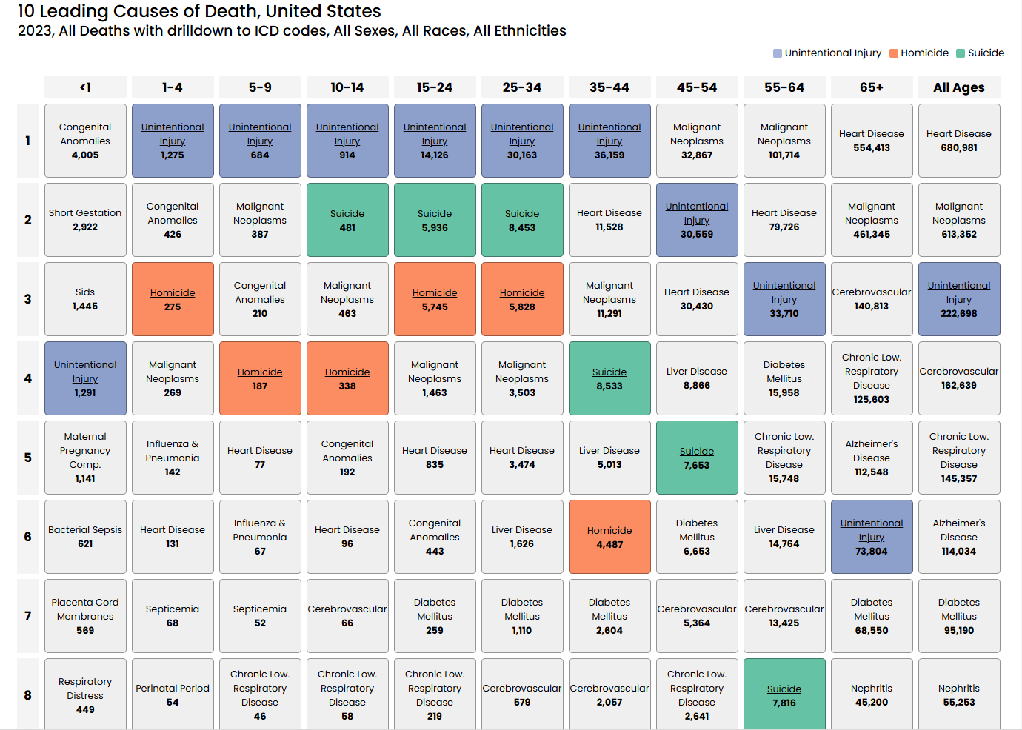
WISQARS Leading Causes of Death Visualization Tool
Notes:
WISQUARS DATA: 2023.
Additionally, if we are able to instill safe habits in these students in their teen years, they will hopefully continue those safe habits into adulthood. As you can see here in the WISQUARS data, Unintentional injuries remain in the top 3 leading causes of death well into the adult years.
I use this data to update some of my slides with statistics for the ThinkFirst for teens Presentations. I have examples of that in the next two slides.

Slide 9


2023 Leading causes of Unintentional Injury: 15–24-year-olds
49.9%
Motor Vehicle, traffic
38.7%
Poisoning
3.7%
Drowning (includes water transport)
Notes:
In TFFT Jackson presentation, we break down the Wisquars data for unintentional injury deaths as you see here in this slide. This is the nationwide data here, but you can change the filters of the data to regional such as the Midwest or Statewide.
We also point out that
Motor vehicle includes all trucks, cars and motorcycles.
Poisoning includes alcohol, prescription and nonprescription drugs.
Drowning includes open waterways, pools and boating.
The 4th leading cause of unintentional injury was other land transport including ATVs
Source: Centers for Disease Control and Prevention, www.cdc.gov

Slide 10
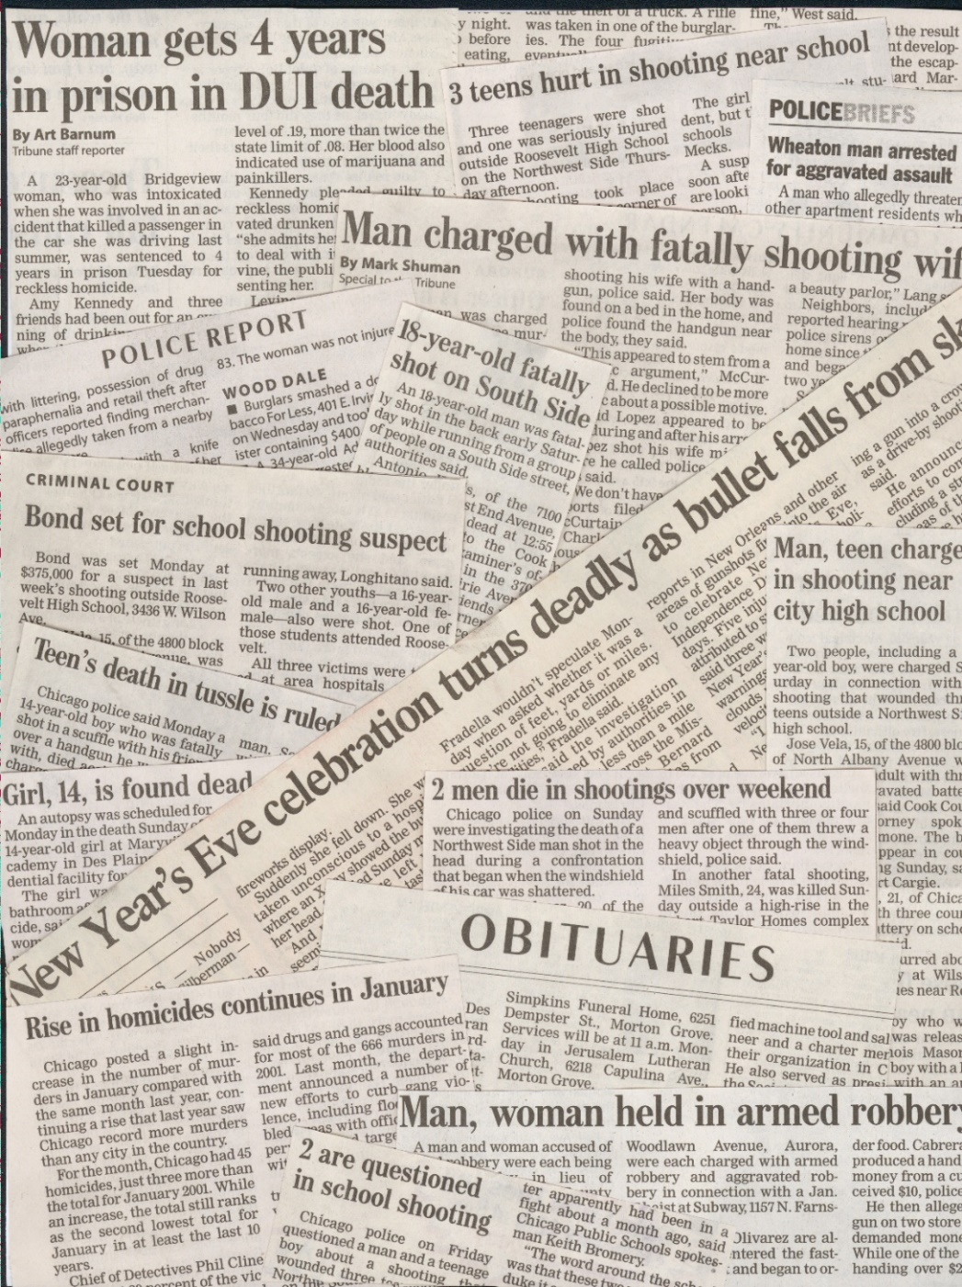
Violence & Interpersonal Violence
2023 Causes of death for 15–24-year-olds:
Suicide
Homicide
Notes:
I also highlight that suicide and homicide are the number 2 and 3 leading causes of death for teens and young adults to emphasize the importance of mental health related care in our country and locally. We discuss kindness, empathy and purpose as well as resources such as 988 and Okay2Say.

Slide 11
Engaging teens with ThinkFirst
10-minute video
Health Education - brain, spinal cord function and injuries
Question prompts in PowerPoint presentation
Voice of Injury Prevention Speaker (VIP)
ThinkFirst Jackson – classroom setting, usually Health Sciences
  Classes are usually only about 40-50minutes
  Split into 2 days, except career center
Notes:
To engage the teens, especially the driving age, there is a 10-minute compelling video that features personal stories from speakers who experienced a traumatic injury after making one poor choice that changed their life.
Health Education PowerPoint Presentation that focuses on brain and spinal cord function and how injuries affect these important parts of the body. The most recent update to the programming includes Discussion with question prompts in PowerPoint presentation.
Voice of Injury Prevention Speaker (VIP) – in person testimony from someone who sustained a life changing injury from one poor choice they made a young age.
Here in Jackson, we use the classroom setting and split the content into two days to allow time for discussion content on day one and the VIP speaker on day two.
Local high school career center, health tech class is a longer class time, so we have the time to complete the presentation and speaker portion in one day.

Slide 12





What is the top cause of fatalities among teenagers?
A. Homicide
B. Injuries
C. Suicide
D. Cancer
Notes:
This is an example of one of the discussion question prompts in the newest ThinkFirst for Teens programming.
Usually there are at least a handful of students that will verbalize an answer.
There are 16 total questions in the full presentation.

Slide 13
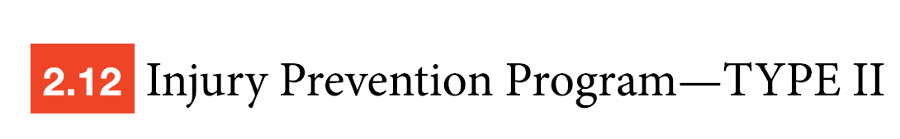
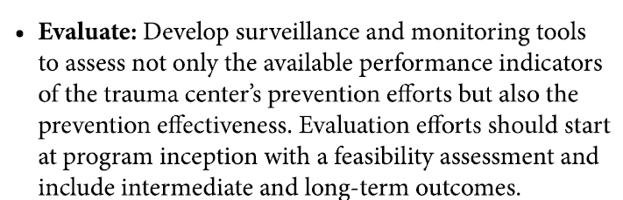
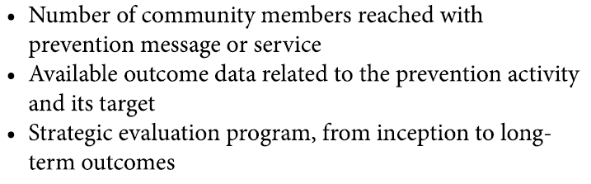
Notes:
This is an excerpt from the American College of Surgeons Resources for Optimal Care of the Injured Patient AKA “the Gray book” describing the requirements for evaluating the injury prevention programs that we implement within our communities.
The lower right bullet points are suggestions in the gray book on how to record injury prevention outreach.

Slide 14

How do we measure our impact?
Number of community members reached
Pre and post survey
Post then Pre survey
Notes:
So, How do we measure our impact?
Recording number of community members reached is often easily doable. Sign in sheets or counting students, ask teacher for a copy of the attendance sheet. Record number of participants in your survey response.
Surveys can be useful when you want to show a knowledge, thought or belief change following a presentation. You might choose a different type of survey depending on how you want to collect data or what type of data you want to collect.

Slide 15
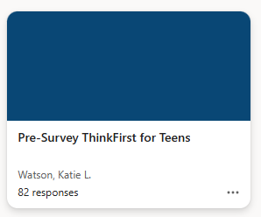
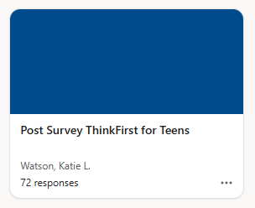
Pre and Post Surveys
Two Surveys
  Asking a similar or same set of questions before and after the presentation or brief intervention.
Can identify improvements in knowledge.
Subject to response shift bias
Change in number of participants from pretest to post test.
Time consuming
Notes:
Using pre- and post-survey instruments in interventions: determining the random response benchmark and its implications for measuring effectiveness - PMC
Pre and post surveys are completed before and after a presentation where a similar or same set of questions are asked before and following the education or presentation provided.
This type of survey can be beneficial in identifying improvements in knowledge, or changes in thoughts/beliefs on the topics.
However, the pre and post survey can be subject to response shift bias-
Response shift bias – When a learning experience or an intervention can change the participants perspective or understanding of a concept between the pre and post test. Where the pretest answers are based on what individual may perceive they know versus what they discover they actually know following the learning experience. Or, you may have students answering a certain way intentionally. I have an example of that on the next slide.
Change in number of participants in pretest to post test time can also happen as you can see here, I have experienced this. Some students either choose not to participate or leave the class early (career center).
A pre and post survey can also be time consuming when you already have limited time in the classroom.

Slide 16
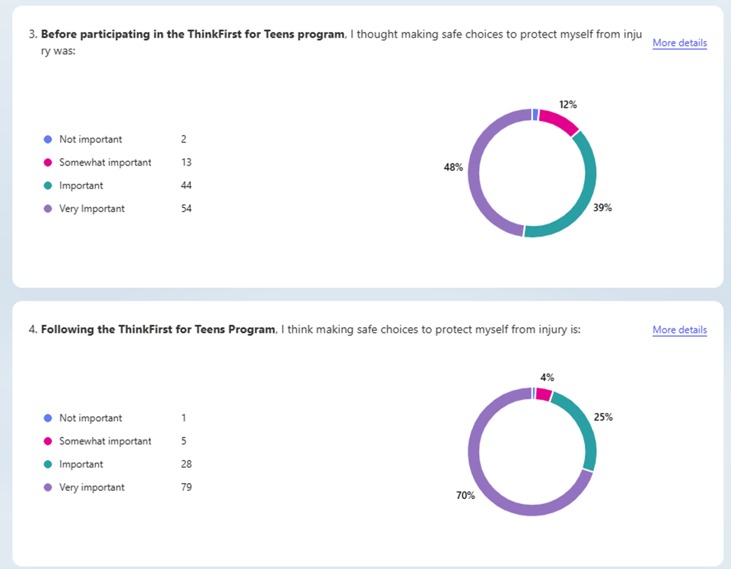
Post/Pre Survey
Single Survey
  Before and after intervention information collected at the same time.
Can reduce response shift bias.
Simplified data
Consider age
Response bias
Time consuming
Using the Retrospective Post-then-Pre Questionnaire Design
Notes:
With the retrospective Post/pre survey you have the benefit of one survey versus two. All questions are given at the end of the presentation and ask about thoughts before the presentation and thoughts/feelings after the presentation. Example shown in the picture here.
This type of data collection is somewhat simplified since you are collecting it all at the same time in one complete survey.
This image is a good example showing how the training increased their concerns of safety and the importance of protecting themselves from injury. Very important 48%-70% **Go over important and somewhat important
Consider age in understanding survey design, remind students to carefully read each question. May be a difficult question format for younger audience to understand.
Can still have response shift bias
As you can see in the image, someone just really doesn’t believe that safe choices are important.
Still can be time consuming depending on how much time you have in the classroom; you may have to decrease number of questions or decrease presentation time.

Slide 17
How do we make the presentation and survey implementation interactive?
Notes:
So maybe now we have decided what type of survey we want to use to evaluate our Teen injury prevention presentation. How do we make the presentation and survey implementation interactive?

Slide 18
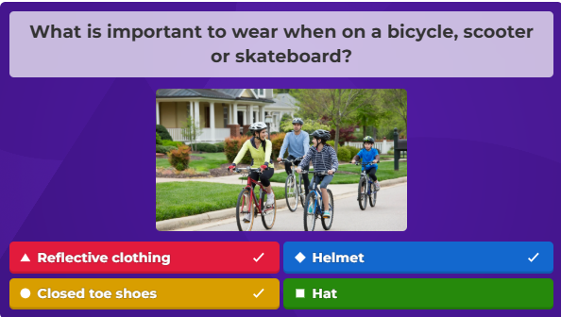
Kahoot! for Presenting and Data Collection
Start with PowerPoint Presentation
Add questions to beginning and end of presentation.
Students answer questions and platform collects data.
Game-like features keep it fun
  Fastest correct answers add points
Notes:
One of the presenters at the conference shared how she uses the Kahoot! platform to engage the middle schoolers that she was presenting TFFT to.
My previous experience with Kahoot! has only been playing the game in a presentation or class for content review. I was intrigued by the use of Kahoot! for not only engagement of the audience but also data collection.
I met with Jessica virtually and she described that Kahoot! is super simple. She was able to use her already created PowerPoint presentation and then add the questions to the beginning and end of her presentation.
Kahoot collects that data as the students are answering the questions.
If you’re not familiar with Kahoot! It has game-like features that keep it competitive and fun for users. Explain image. Answer correctly the fastest gains more points, leaderboard at the end.

Slide 19
Kahoot! Experience Feedback
Since program inception in 2022, completed over 150 Kahoot games and over 1,300 middle schoolers played.
Use the data collected for reports and reporting to grant funding stakeholders.
Evaluate content annually to add or remove questions as needed.
Students respond to competitive nature of the games.
Kahoot platform makes it easy to collect data and gauge education gained during each event.
No identifiers used in game mode.
  Names auto-generated to animal names such as lightning lizard.
Teachers offer small prizes in some schools.
Students can play on Chromebook, laptops, iPads, or cell phones depending on school policies.
Notes:
This is the feedback presented at the ThinkFirst Conference.
The data collection also creates graphs & pie charts.

Slide 20
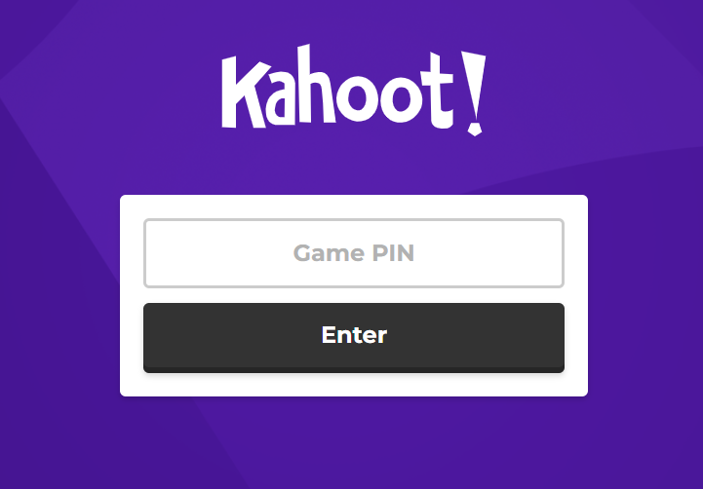
Kahoot! Subscription $$
Platform categories
  Business, teacher, etc.
Subscription levels
  Number of users
  Number of players
  Content creation
  Game mode
  Data collection/reports
Notes:
There is a free version of Kahoot but available features can be limited.
Subscription levels based on preferred Number of users, Number of players, how you want to create content (import files, templates, etc.), whether or not you want Game mode and if you want Data collection/reports.
When I spoke with Jessica, she didn’t remember what subscription level they had because it is shared with other departments at her facility.

Slide 21
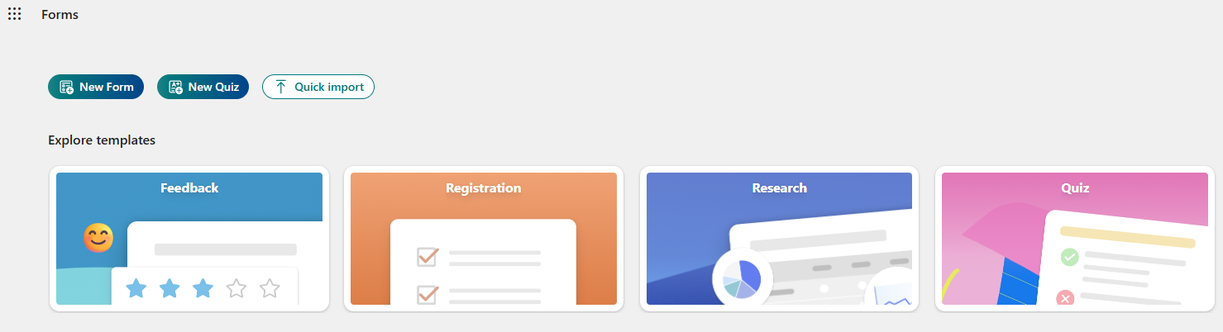
Microsoft Forms
Create or import forms/quizzes/surveys
Template Gallery
Notes:
Another interactive platform option is Microsoft Forms.
This platform is offered at Herny Ford so there is no additional cost to our department for using it. The quick import function allows you to import .pdf or Word files.
With forms, you can create new from scratch or import forms, quizzes and surveys.
There is also template gallery if you need some help getting started with a certain type of form.

Slide 22
Microsoft Forms
Simple feedback
Pre/post
Retrospective Post/Pre
Data Collection
  Export to Excel
Lacks game mode
Notes:
Microsoft forms can be used for various needs such as simple feedback questionnaires or surveys, pre/post survey or tests, Post/Pre, data collection.
Can export data to excel.
However, lacks the game mode.

Slide 23

Retrospective Post/Pre Survey results 2023-2024
Notes:
From 2023-2024 I used Microsoft Forms to incorporate a Post/pre survey following the ThinkFirst for Teens presentation.
At that time, M. F. was not this interactive. I created a QR code for the Survey and placed it on the last slide of the presentation for the students to scan and complete.
Now with this interactive version, I would have the ability to review the live results during my presentation.

Slide 24
Other survey platforms to explore
Survey Monkey
Google Forms
Mentimeter
Jotform
Qualtrics
Likely many more
Notes:
I know that Kahoot! and Microsoft forms are not the only electronic survey tools out there. I believe it is important to acknowledge some of these other options as well. I personally have not worked with any of them enough to speak about the pros/cons of using them.
Because Microsoft forms is easily available for me, I was more interested in comparing that to Kahoot!

Slide 25
Take Aways
ThinkFirst is a National Injury Prevention Foundation with a mission of preventing brain, spinal cord and other traumatic injuries through education, research and advocacy.
ThinkFirst provides Injury Prevention Programs for all ages based on National injury data.
Pre/post and Retrospective Post/Pre evaluation methods can be effective depending on what type of information you want to collect.
Various virtual platforms are available to present surveys to program participants.
  Some platforms are more interactive than others.

Slide 26
References
Colosi, L. and Dunifon, R. (2006) “What's the difference? “Post then pre” & “pre then post”.” Cornell Cooperative Extension. p1-8
Grella, Jessica. MPH, CPSTI. Injury Prevention Coordinator/Community Health Educator, Pediatric Trauma at Cohen Children's Medical Center. NYS ThinkFirst Chapter Secretary. Personal interview, 2025.
Using the retrospective post-then-pre questionnaire design. UW Madison Division of Extension-Program Development and Evaluation. (2021). Retrieved from https://fyi.extension.wisc.edu/programdevelopment/files/2021/12/RetrospectivePost-then-Pre.pdf
Wisqars leading causes of Death Visualization Tool. Web-based Injury Statistics Query and Reporting System (WISQUARS). (2023). Centers for Disease Control and Prevention. https://wisqars.cdc.gov/lcd

Slide 27
Questions?
Kwatson9@hfhs.org

