Slide 1
The Cost of Saving Lives:
Why Trauma Programs Need to Prioritize Trauma Finance
12/10/25
Dr. Andie Young, DMSc, PA-C, TPM
Trinity Health Oakland

Slide 2
Disclosures
No Disclosures

Slide 3

Overview
Describe key trauma finance principles/codes/charges
Share common gaps in charge capture
Share how we applied these learnings at Trinity Health Oakland
Outline next steps to advance your trauma finance stewardship

Slide 4
What is Trauma Finance and Why is it Important?
The expenses and revenue involved in maintaining trauma center operations
The cost of saving lives includes (but is not limited to):
  On-call contracts
  In-house staff FTE
  Resources to maintain ACS standards (e.g. peds readiness/Eprep)
  Equipment (think big)
  Trauma registries, trauma administrative staff etc
It’s also important to understand how your program indirectly adds value!

Slide 5
068x - Revenue Category for Trauma Centers
Revenue category for trauma centers:
  “068x”
  Level 1 = 0681
  Level 2 = 0682
  Level 3 = 0683
  Level 4 = 0684
Trinity Health Oakland Level II Trauma Center = 0682
  Reported when pre-notification documented
  Not limited to admitted patients
  Tied to FL14 type 5
Pre-notification may be obtained from:
EMS/Fire/Police/ Helicopter
Referring hospital, Urgent Care, Physician, Office and/or Clinic
Arriving by private vehicle through ED triage is NOT pre-notification.

Slide 6
068x - Revenue Category for Trauma Centers
Don’t worry – if you can’t capture a 068x response fee, an ED 450 Service Code can be utilized if trauma activation services were rendered WITHOUT pre-notification.
OFIs:
Determine if you center reviews your Full and Partial activation fees
Educate ED providers
Educate Pre-hospital providers
Track your pre-notification rates

Slide 7
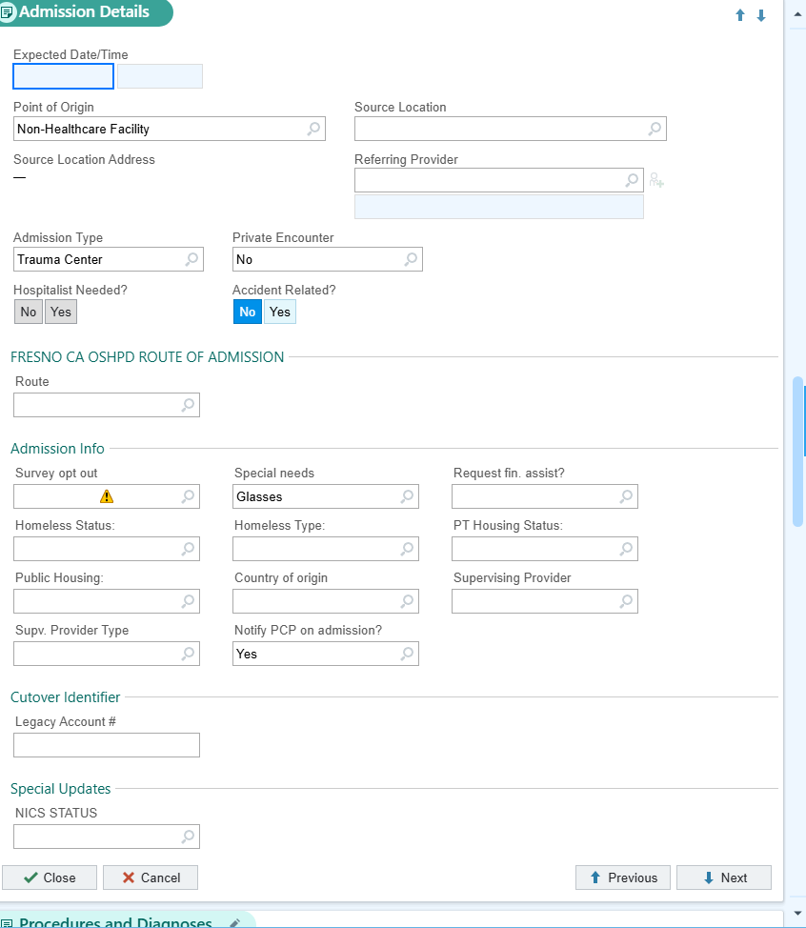
FL14 type 5 – Primary Indicator of Trauma Patients
  Only for Full/Partial trauma activations
    With or without pre-notification
    Tied to 068x code
  OFIs:
  Determine who updates the admission type in your EMR
  Educate your TRs/MCRs
  Determine a way to communicate patients that are seen on consult (e.g. Charge Capture/Trauma patient encounter list)

Slide 8
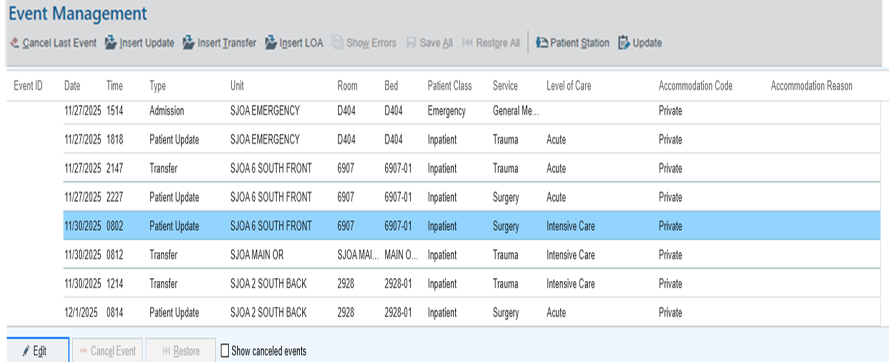
Revenue Code 0208 – Trauma Patients in the ICU
Only used for trauma pts admitted to ICU
Trauma MUST follow the patient throughout their entire ICU stay to utilize 0208
OFIs:
Reconcile Trauma ICU charges
Educate ICU providers
Educate your TRs/MCRs

Slide 9
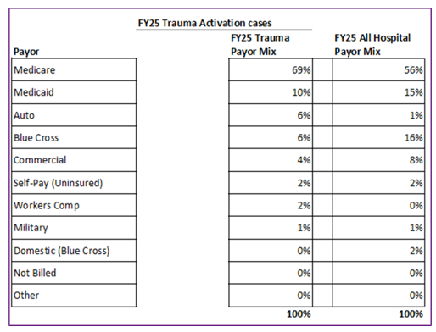
Know Your Payor Mix / Payor Sources
Major Payers:
  Medicare
  Medicaid
  Commercial insurance
  Inpatient and outpatient hospital payments to hospitals vary by payor

Slide 10
Next Steps to Build Your Trauma Finance Stewardship

Slide 11

Next Steps: Join TCAA
Become a TCAA member
Take the Basic Finance and Advanced Finance Courses
    Invite your Revenue and Integrity partners
    Don’t forget to apply for an MTC educational scholarship!
Reference the TCAA Trauma Center Finance and Operations Resource Manual
State System Member Application - Trauma Center Association of America (TCAA)

Slide 12
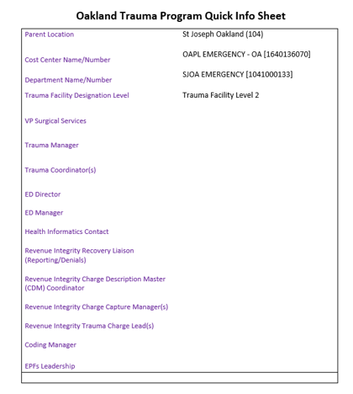
Next Steps: Identify Your Team
Create a quick reference sheet:
  R&I Recovery Liaison (reporting/denials)
  R&I Charge Capture (manager)
  R&I Charge Lead (those entering in charges on your trauma patient encounter list)
  Coding Manager
  CFO, Finance President, Finance analyst etc
  ED Director, Manager
  TPM, TMD
  TR, MCR, PI etc

Slide 13
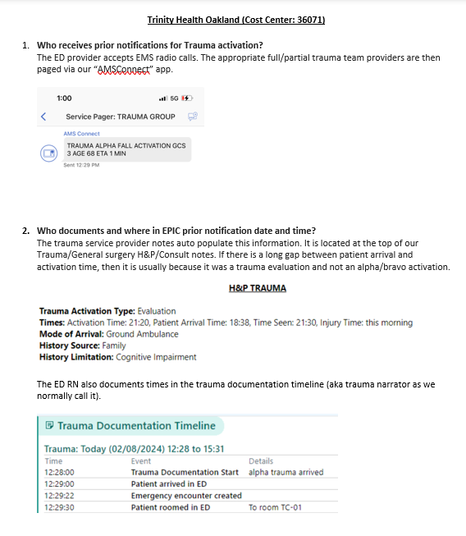
Next Steps: Level Set with R&I/Finance Departments
  Share how your trauma program works:
    Who receives pre-notifications for Trauma activation?
    Pre-notification date/time is updated by who/where in Epic?
    Trauma team arrival date/time is documented by who/where in EPIC?
    How do you document Trauma patients (e.g. Epic)?
    Who enters patient Acuity in EPIC?
    Who educates outside entities on need for prior notification when it does not occur?

Slide 14
Next Steps: Level Set with R&I/Finance Departments
  Find out what info the R&I team needs from you:
  Who updates Admission Type to Trauma (FL 14 type 5) and when?
  Who populates the Charge Capture/Patient Encounter List and when?
  Who reviews Trauma ICU Admitted patients bed assignment to confirm they are listed under the Trauma Service?
  How do you plan to reconcile these charges?
  Does revenue get directed to your trauma cost center?

Slide 15
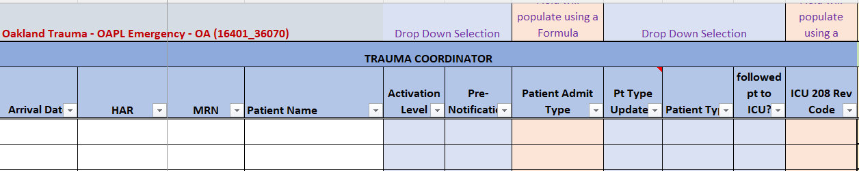
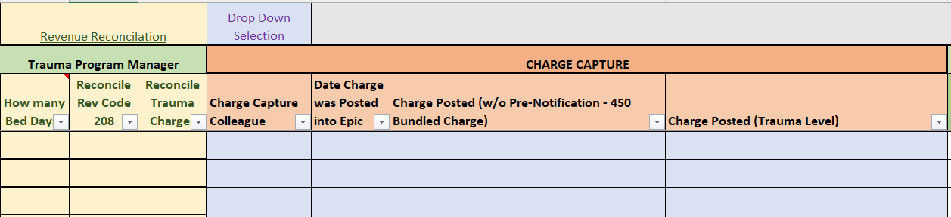
Next Steps: Build Your Charge Capture/Trauma Patient Encounter List

Slide 16
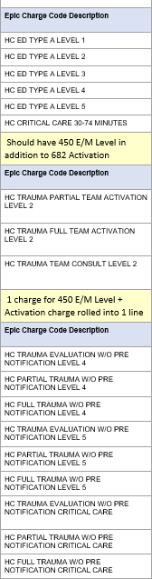
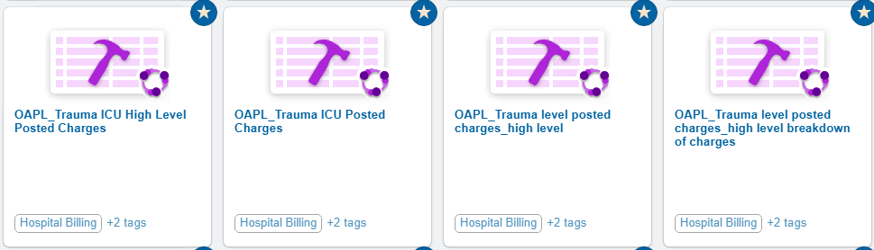
Next Steps: Build a Trauma Finance Report

Slide 17
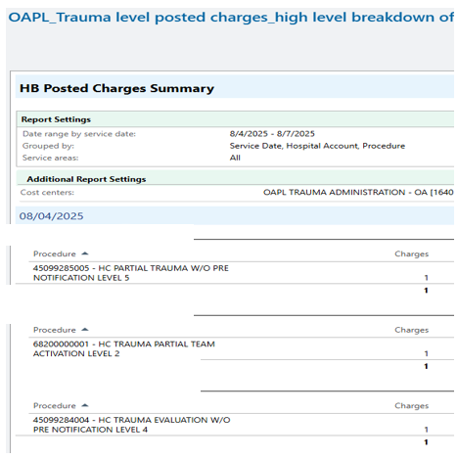
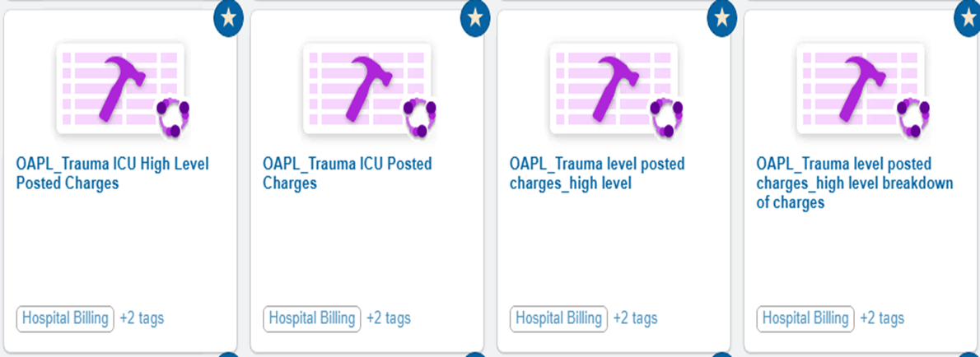



Next Steps: Start Trauma Finance Reconciliation – Trauma Charges

Slide 18
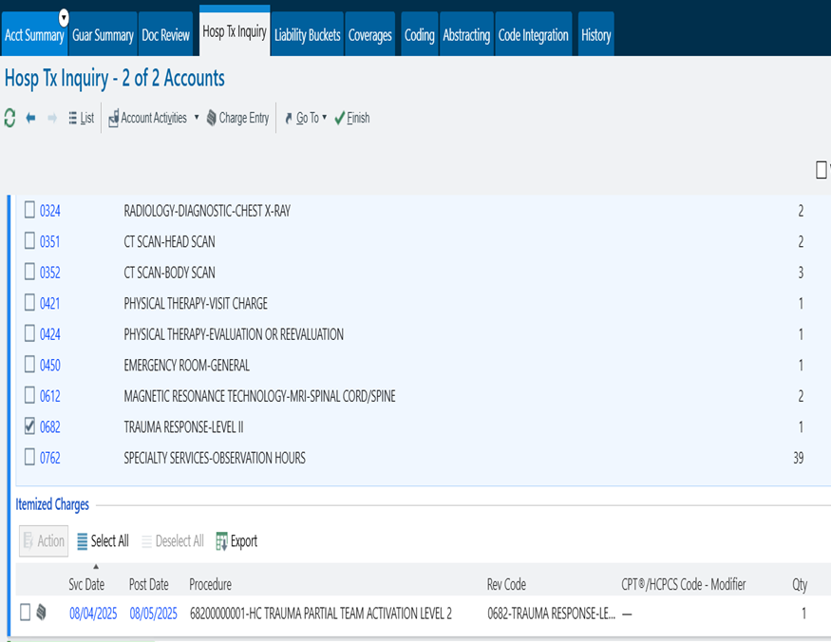
Next Steps: Start Trauma Finance Reconciliation – Trauma Charges

Slide 19
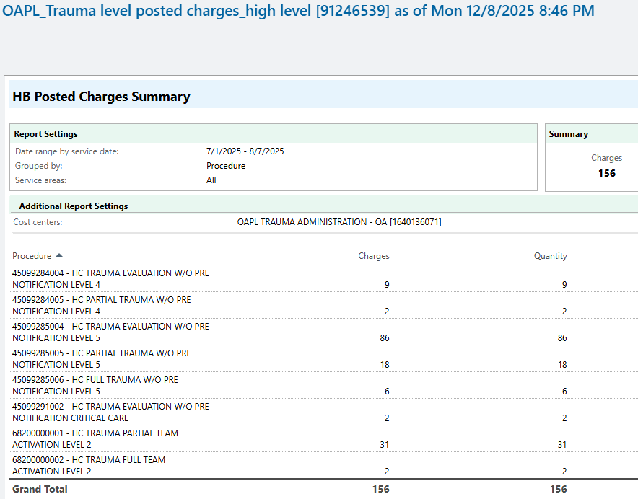
Next Steps: Start Trauma Finance Reconciliation – Trauma Charges

Slide 20
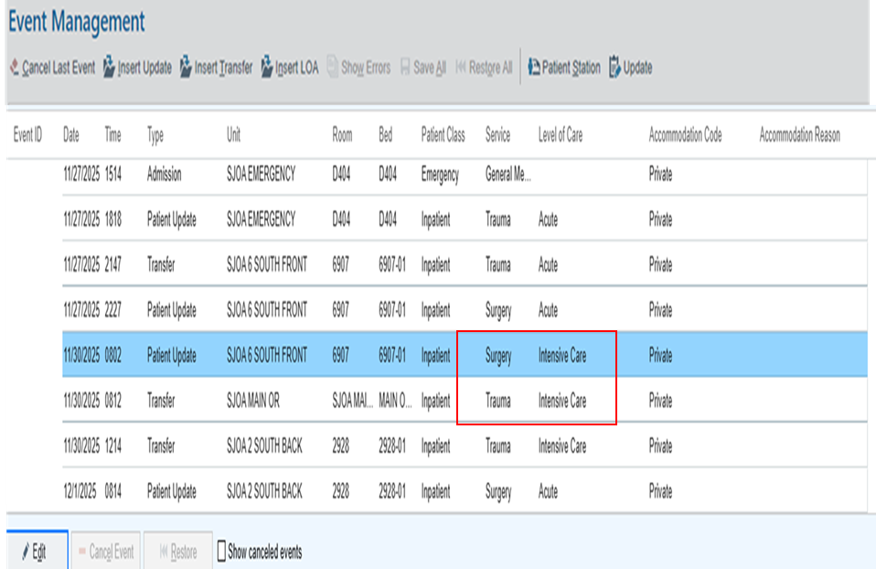
Next Steps: Start Trauma Finance Reconciliation – Trauma ICU Charges

Slide 21
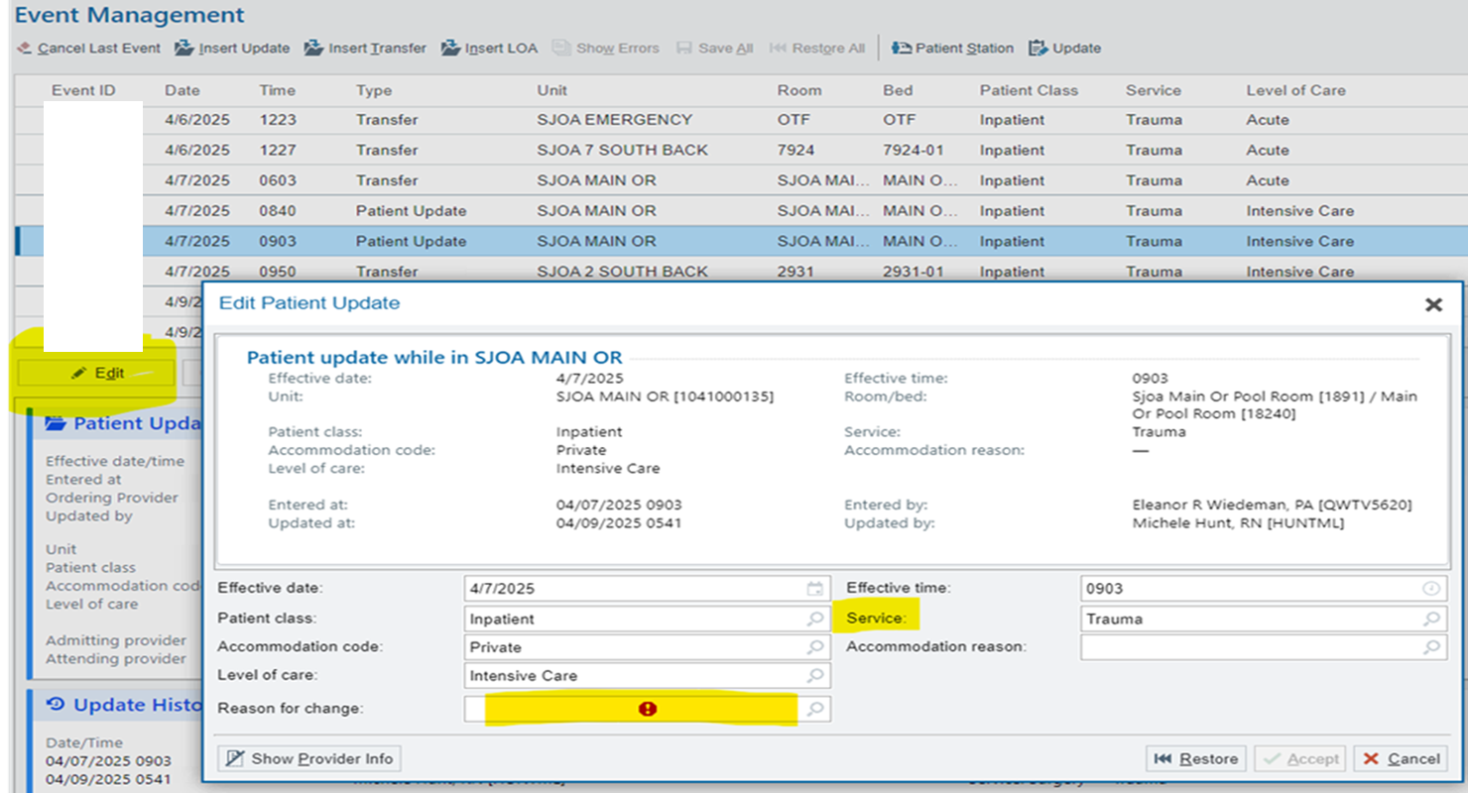
Next Steps: Start Trauma Finance Reconciliation – Trauma ICU Charges

Slide 22
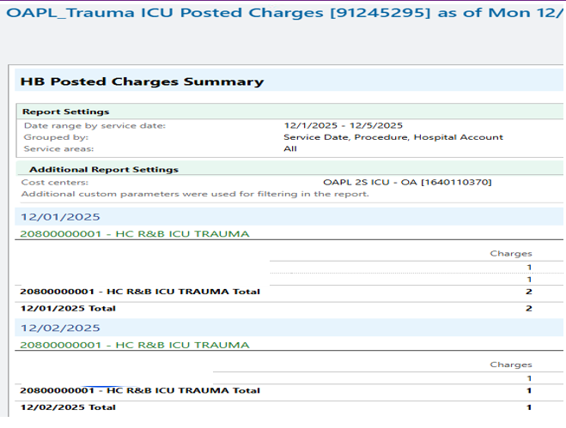

Next Steps: Start Trauma Finance Reconciliation – Trauma ICU Charges

Slide 23
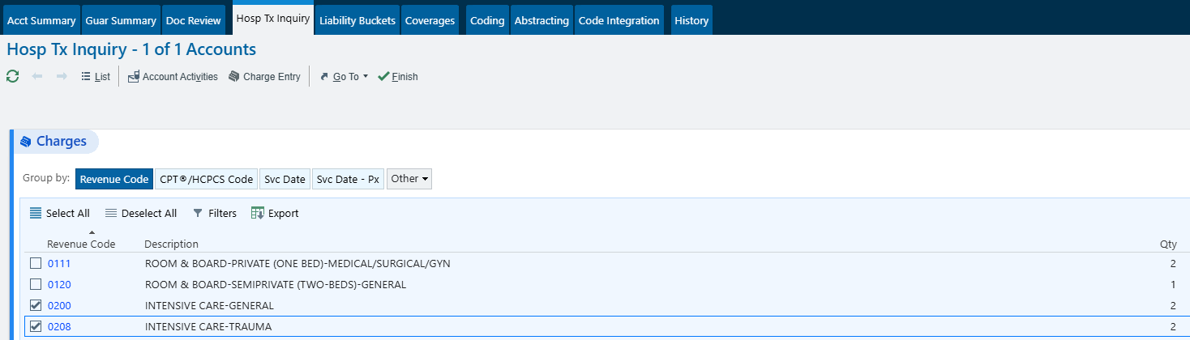
Next Steps: Start Trauma Finance Reconciliation – Trauma ICU Charges

Slide 24
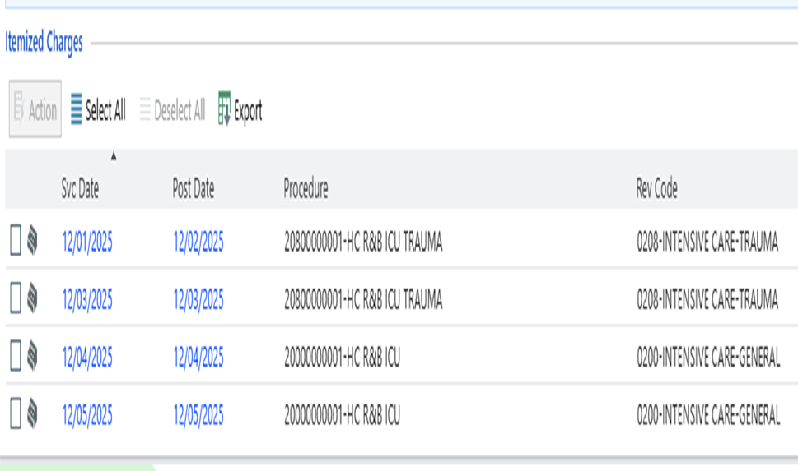
Next Steps: Start Trauma Finance Reconciliation – Trauma ICU Charges

Slide 25
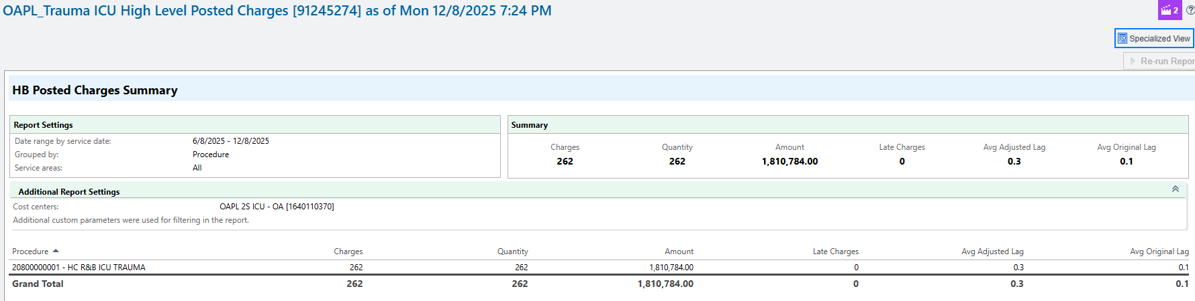
Next Steps: Start Trauma Finance Reconciliation – Trauma ICU Charges

Slide 26
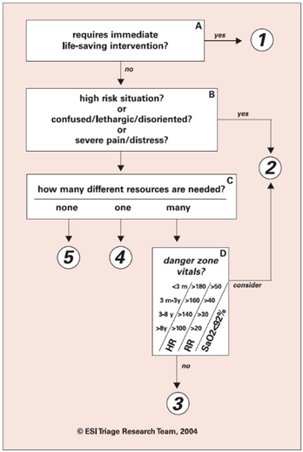
Next Steps: Work to Improve Documentation
Work to increase revenue by:
  Detailed/correct injury diagnoses
  Ensuring trauma activation details are documented
  Ensuring accurate ESI acuity and documentation
Nursing documentation can also support critical care provider and/or hospital billing.

Slide 27
Next Steps: Develop a Trauma PI Finance Committee
Strongly recommended by TCAA
Review current practice and ensure accuracy in billing
Include:
  Trauma Program Manager/Director
  Trauma PI Coordinator
  Billing/Coding Team
  Revenue & Integrity Team
  Denial Avoidance Team
  Chargemaster
  Revenue Leadership
  HIM team
  Registration team
  Trauma Registry lead
  Executive leadership champion/sponsor

Slide 28
Final Step: Use Your New Trauma Finance Knowledge on Senior Leadership!
If requesting new/additional FTE/resources, add as much information to your SBAR as possible:
  Include the data that supports your request
  ACS standards and/or previous weakness/OFIs
  BCBS/MTQIP contributions
  Grants/Philanthropy
  How you’ve worked to increase trauma revenue

Slide 29
Questions?
THANK YOU!

